Slide 1
Steps to Manual Scoring of Iowa Assessment
Statewide Academic Achievement Test
English Learner Reclassification
for Grades 1, 2, 11, and 12
Notes:
Title: Texas English Learner Reclassification-- _DataManager: Set up and Test Administration
Thank you for joining this webinar to learn about the setup of the DataManager platform for the Texas Statewide Academic Achievement Test for English Learner Reclassification for Grades 1, 2, 11, and 12

Slide 2

Learning Objectives:
Overview
Iowa Assessments
Paper Pencil Administration
Hand scoring
Raw Score
Standard Score
National Percentile
Hands On
Q & A
Notes:
In this session, we will focus on how to hand score the Iowa assessment – how to determine the raw score and the process to use that raw score to determine the standard score and the percentile score.

Slide 3


The Iowa Assessments
The Iowa Assessments have been a trusted component of assessment programs across the country since 1935.
They were first developed by the Iowa Testing Programs (ITP), a research, development, and outreach unit in the College of Education at the University of Iowa.
The Iowa Testing Programs were the first comprehensive statewide elementary and secondary testing programs in the nation.
On average, nearly 10 million students are assessed using the Iowa Assessments each year.
Almost half of all Catholic dioceses across the nation count on the Iowa Assessments as an integral part of their assessment programs.
Notes:
The Iowa is a norm referenced test is for students in Grades K – 12.
It’s a comprehensive measurement of student achievement of the mastery of core standards.

Slide 4
Iowa Assessments, Form F
Survey Battery, Norms 2017
  Consumable, Grades 1-2
    Reading
    Language
Complete Battery, Norms 2017
  Reusable, Answer Document, Grades 11-12
    Reading
    Written Expression
  Grades 11-12
  Grades 1-2
Notes:
For the Texas Reclassification testing, you will be administering the Iowa Survey Battery, to Grades 1-2 = the reading and Language subtests only – and the Complete Battery, to , Grades 11-12 – the Reading and Written Expression subtests only

Slide 5



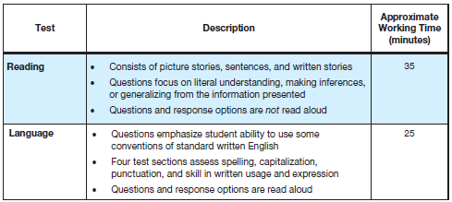
1st and 2nd Grade Iowa Survey
Survey:
  Abbreviated battery for Reading, Language, and Math
  Students are only required to take Reading & Language subtests
Refer to Directions for Administration
Notes:
The 1st and second grade test is not timed. The approximate working time for the Reading subtest is 35 minute and for the Language subtest is 25 min.

Slide 6
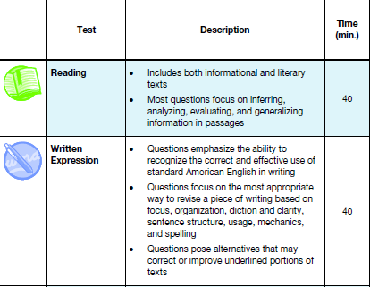

11th and 12th Grade Iowa Complete
Complete:
  All content areas including Reading, Language, Math, Science and Social Studies
  Students are only required to take Reading & Written Expression
Refer to Directions for Administration
Notes:
The reading and written expression subtests for grades 11 and 12 are timed at 40 minutes each. It is very important that you keep accurate time when testing students.

Slide 7

Paper/Pencil Administration
Notes:
Now we will learn some important steps in administering the Iowa. As the Iowa is a norm referenced test, It is very important to follow all steps accurately in order to get the valid scores

Slide 8
Iowa Assessments
Paper Administration
All test administrators must read and adhere to the Directions for Administration(DFA) in order to maintain security and reliability.
Notes:
Each level of the test is color coded.
Student in 1st grade will take the level 7 test and 2nd grade students will take the level 8 test
The Direction for Test Administration will color coordinate to the test booklet along with the scan document for 11th and 12th grade
Students in 1st and 2nd grade will bubble in the answers in their booklet

Slide 9
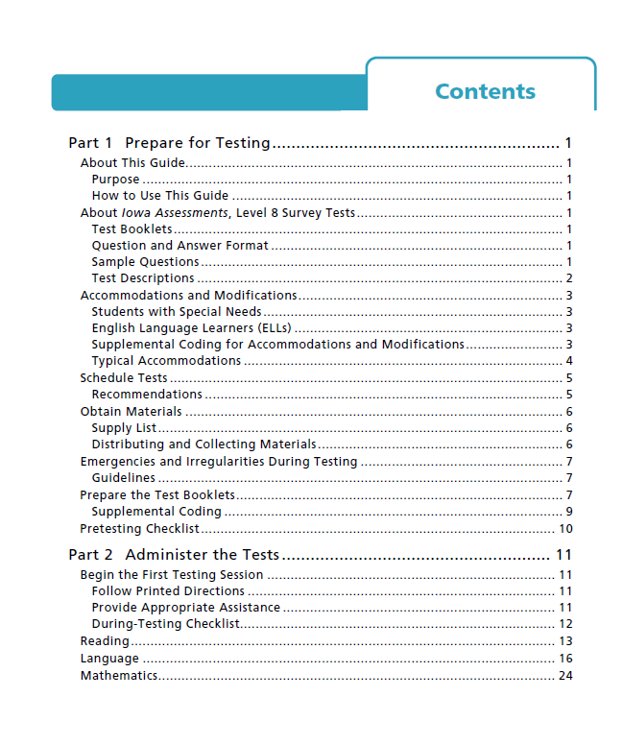
Table of Contents
Notes:
In the table of contents of the Directions for Administration, Part 1 tells how to prepare for testing
Part 2 will give the script to read to students for each subtest

Slide 10
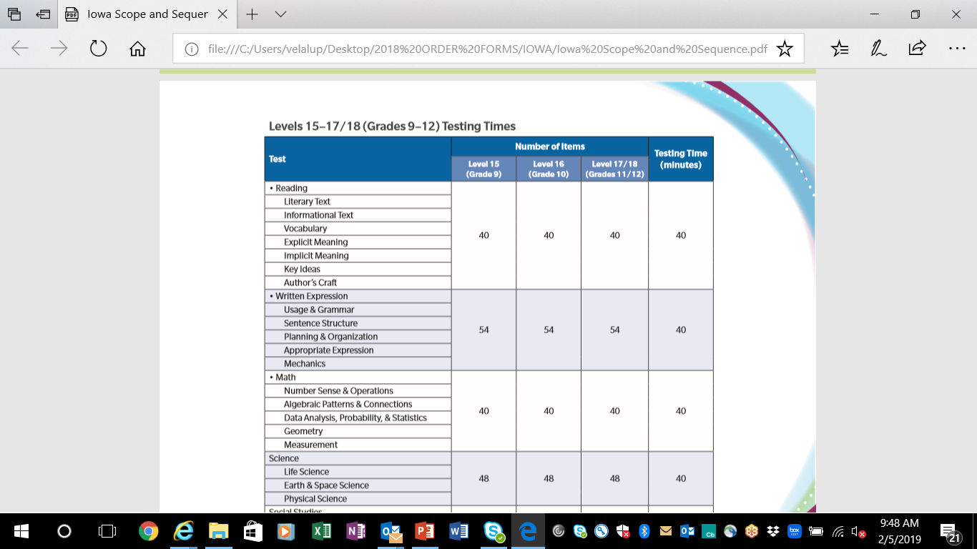
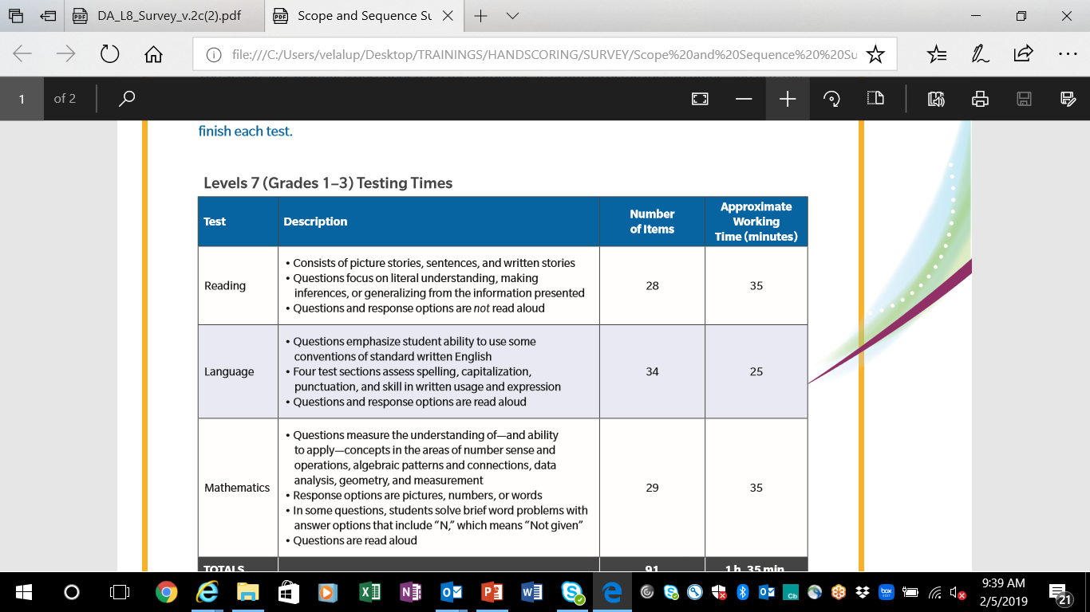
Iowa Assessments, Form F Test Descriptions and Times
Number of Items
Grades 1-2
Grades 11-12
Notes:
Each Directions for Administration book will have a scope and sequence which shows the order of the subtest, the estimated working time, and number of questions

Slide 11
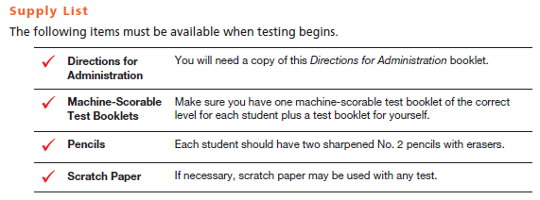
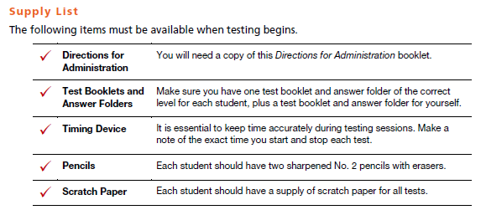
Supply List
Grades 1-2
Grades 11-12
Notes:
Each Directions for Administration book will have a list of required supplies
All students may have scratch paper
1 & 2 and grade students will answer in machine scorable books
11th and 12th will answer on a separate answer document

Slide 12
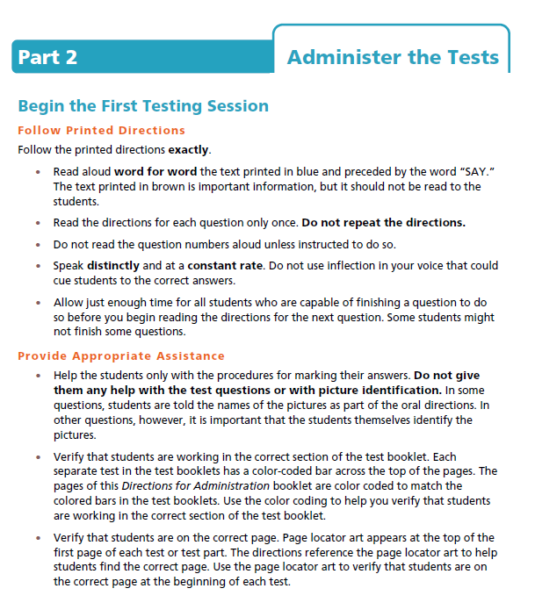
1st & 2nd Grade
Directions
Read aloud word for word
Do NOT repeat directions
Do NOT read question numbers
Speak slowly and distinctly at a constant
No emphasis on words
Notes:
The directions for administration provide explicit directions of what you are to say and do as well as what you are not to say and do as you can see here.

Slide 13
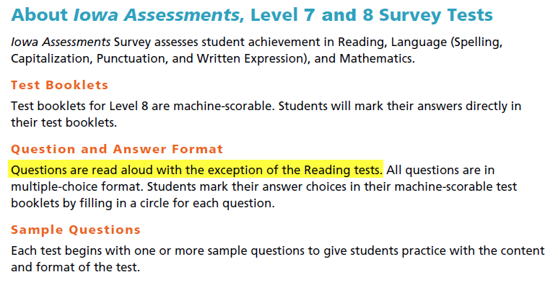
Administering Iowa Assessment:
Levels 7 & 8 (Grades 1 & 2)
Notes:
For grades 1 and 2, students respond to multiple choice test questions in their test booklets. Each subtest begins with sample questions to give students an introduction to the test content.

Slide 14
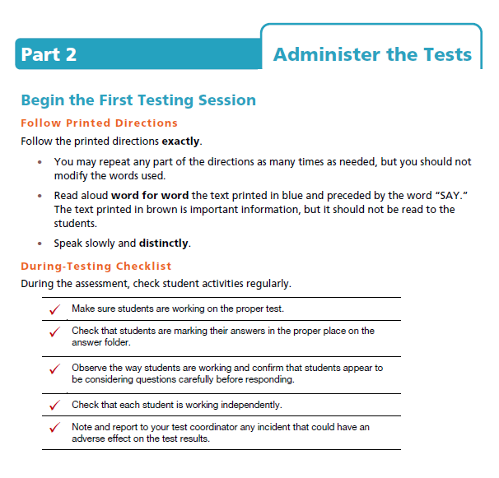
11th & 12th Grade
Directions
Follow printed directions exactly as written
Read word for word
Speak slowly and distinctly
Monitor time limit
Make sure students are working independently
Notes:
For grades 11 and 12
Follow printed directions exactly as written
Read word for word while speaking slowly and distinctly
Students will have 40 minutes to complete each subtest; use a clock, a stopwatch or the stopwatch feature on your phone to monitor the time and stop student testing after 40 minutest

Slide 15
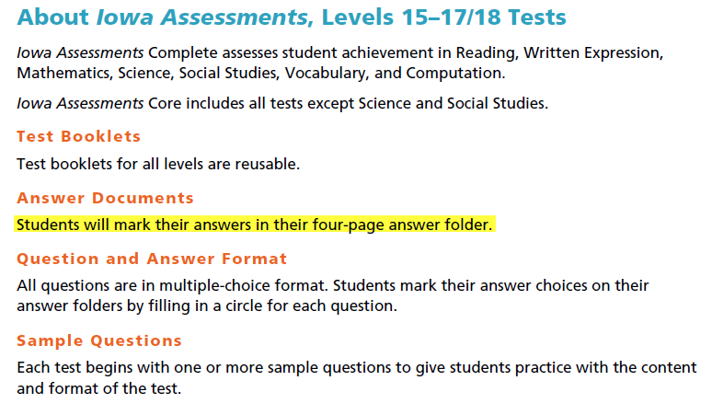
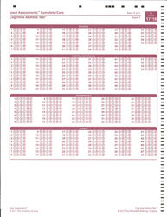
Administering Iowa Assessment:
Levels 9-18 (Grades 3-12)
Notes:
For grades 11 and 12, students respond to multiple choice test questions in their test answer folder. Each subtest begins with sample questions to give students an introduction to the test content.

Slide 16

During the Test
Everything to be read to the students will appear in BLUE.
Read materials exactly as they are written.
If a mistake is made in reading a direction or question, stop and say," No, that is wrong. Listen again.” Then read the direction or question through again.
Monitor students during the tests.
Notes:
All text to be read to the students will be in blue print in your directions for administration book.
Read materials exactly as they are written, using a natural tone. Be very careful of voice inflection.
If a mistake is made in reading a direction or question, stop and say," No, that is wrong. Listen again.” Then read the direction or question through again.
Test Administrators must monitor students during the tests by moving around the room and checking that students are on the correct page and marking answers within the circle with a dark mark.

Slide 17
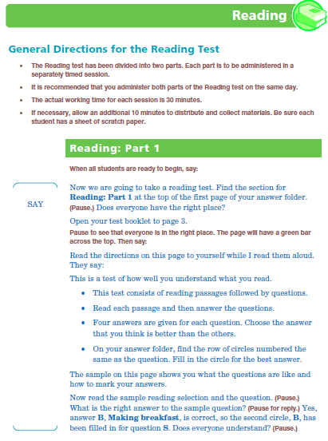
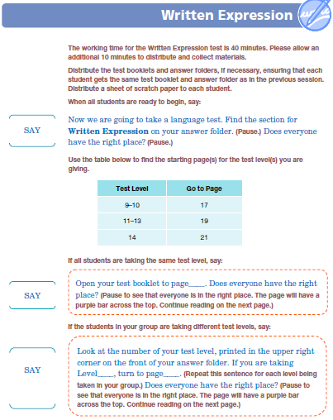
Iowa Sample Directions for Subtests
Notes:
Text in brown print gives the proctor information on what to do such as pass out scratch paper or make sure they are on the correct screen .
Text in blue , proceeded by the word say, is what is to be read aloud to students verbatim

Slide 18

Hand Scoring
Notes:
After you have successfully administered the test, you will need to hand score the documents

Slide 19
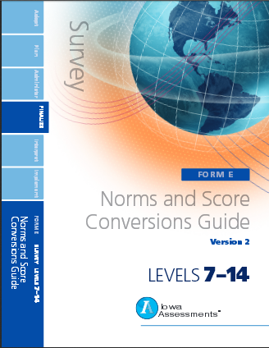
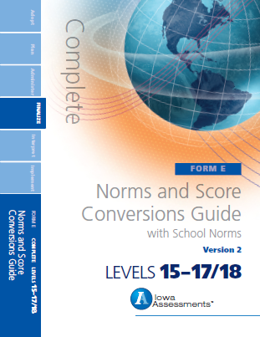
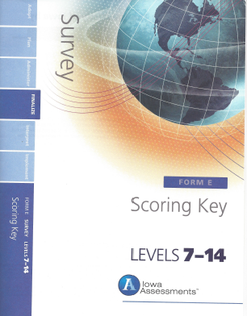
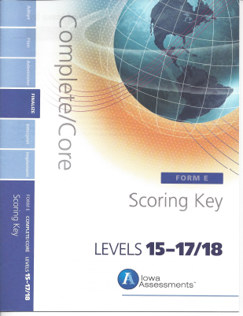
Needed Supplies
Form F, Survey Battery:
Consumable Test Book
_ Grade 1/Level 7
_ Grade 2/Level 8
Form F, Complete Battery:
Reusable Test Book
Answer Document
_ Grades 11/12/Level 17/18
Form F, Scoring Key:
Iowa Survey, levels 7-14
Iowa Complete, levels 15-17/18
2017 Form F, Norms and Score Conversions Guide:
Survey, levels 7-14
Complete, levels 15-17/18
Notes:
To manually score, you will need the students answer document, the scoring key, and the Norms and Score Conversion Guide

Slide 20
How To Hand Score
1. Count the number correct
Raw Score
(RS)
2. Convert RS to SS
Standard
Score
(SS)
3. Convert SS to PR
Percentile
Rank
(PR)
Use the scoring key to count the Raw Score (number correct)
Use the norms and conversions guide to convert
Notes:
To score each test, we are going to walk through how to obtain the raw score, then how to convert the raw score to a standard score, and finally how to convert the standard score to a percentile score.

Slide 21

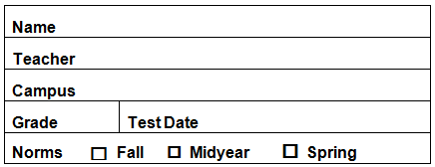

Iowa Assessments, Form F, 2017 Norms
Fall August 1st – November 29th
Midyear December 1st – February 29th
Spring March 1st – July 31st
Survey Battery Skill Subtests (Gr. 1/Level 7 and Grade 2/Level 8 Consumable Test Books)
Use the Iowa Assessments Norms and Score Conversions Guide for the Survey Battery, Levels 7-14 (Student Norms) | Raw Score (RS) | Standard Score (SS) | Percentile Rank (PR)
1. Survey Reading (SR) | / |  | %
2. Survey Language/Written Expression (SL/SWE) | / |  | %
Complete Battery Skill Subtests (Gr. 11-12/Levels 17/18 Reusable Test Book/Answer Document)
Use the Iowa Assessments Norms and Score Conversions Guide for the Complete Battery, Levels 15-17/18 (Student Norms) | Raw Score (RS) | Standard Score (SS) | Percentile Rank (PR)
1. Reading (R) | / |  | %
2. Written Expression (WE) | / |  | %
Tester: ________________________________ Date: ___/___/___

Slide 22
Step 1: Use the answer key and obtain the student’s raw score (the number of items answered correctly)
Notes:
The first step is to calculate the students raw score – the number of items they answered correctly. Use the scoring key to determine the number of items answered correctly.

Slide 23
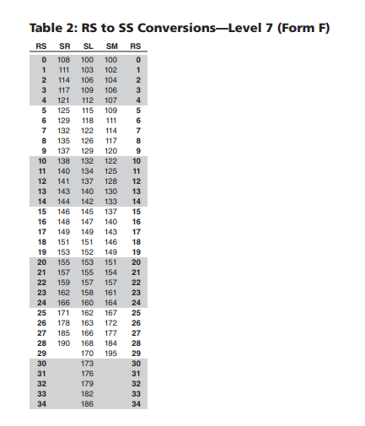
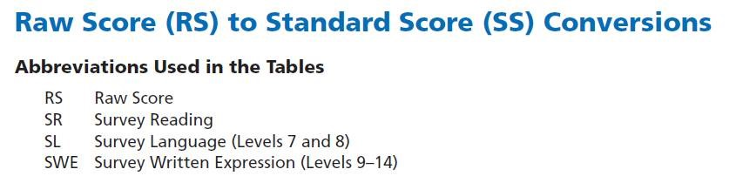
Step 2: Convert Raw Score to Scaled Score
Grade 1 | Table 2
Grade 2 | Table 4
Grade 11 and 12 | Table 6
Notes:
Using the Norms and Score conversions guide for the level of test that you are scoring, locate the student’s raw score in the appropriate table and find scaled score that corresponds to the student’s raw score.
Here is an example for grade 1/level 7 with a student’s raw score of 15 .. We find the Scaled Score for reading is 146 and for Language is 145.

Slide 24
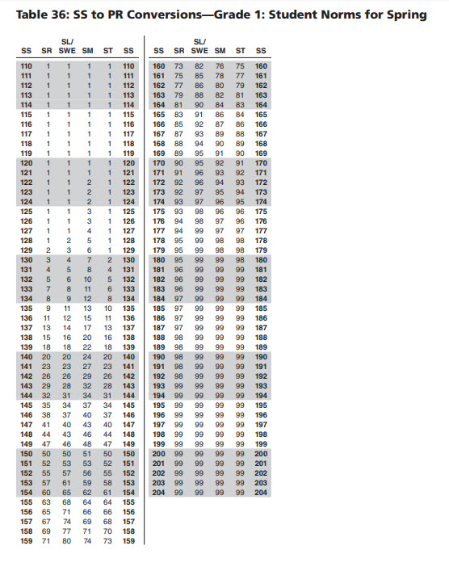
Step 3: Convert the Scaled Score to Percentile Score
Grade 1 | Table 36
Grade 2 | Table 37
Grade 11 | Table 21
Grade 12 | Table 22
Notes:
Using the Norms and Score conversions guide for the level of test that you are scoring, locate the student’s scaled score in the appropriate table for SPRING and find the percentile score that corresponds to the student’s scaled score.
For the student who had Scaled Score for reading of 146 and for Language of 145 – we see that the student has a percentile sore of 38 for Reading and CLICK 34 for math

Slide 25

Hands on Practice
Notes:
Slides 26 through 28 are for the onsite sessions only.

Slide 26
Hands On Practice
Take the test
  Fill out answer document for both Reading and Written Expression
    Have fun! Select random answers, make patterns, make all the same, etc.
Score the test
  Count correct answers
  Record the score in box
Record Scores:
  Enter Raw Score (RS)
  Convert Raw Score (RS) to Standard Score (SS)
  Convert Standard Score (SS) to Percentile Rank (PR)

Slide 27


